Slide 1

Antonio Reybol Jr| Apurva Sharma| Klejsierta Xhumari | Laura Pacas Samantha Wang | Zi Jian Zheng
Movie Matrix
Team Mediax

Slide 2

Mission Statement
Our goal is to analyze what attributes contribute to a movie's revenue based on multiple variables, to help movie makers create high revenue movies

Slide 3

Solution
Provide users detailed analyses of top selling movies and their info
Correlation Matrix: Find correlations among revenue and other factors
Linear Regression Model: Predict movie revenues
This Photo by Unknown Author is licensed under CC BY-SA-NC
Notes:
Sanket will explain in detail about the process

Slide 4
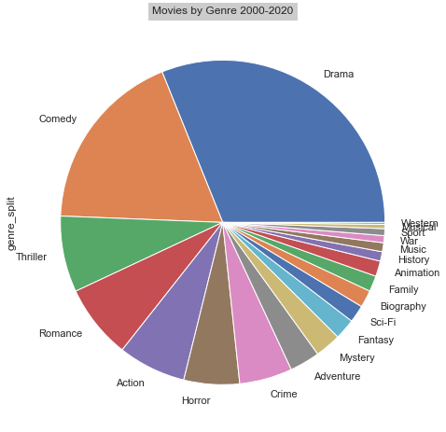
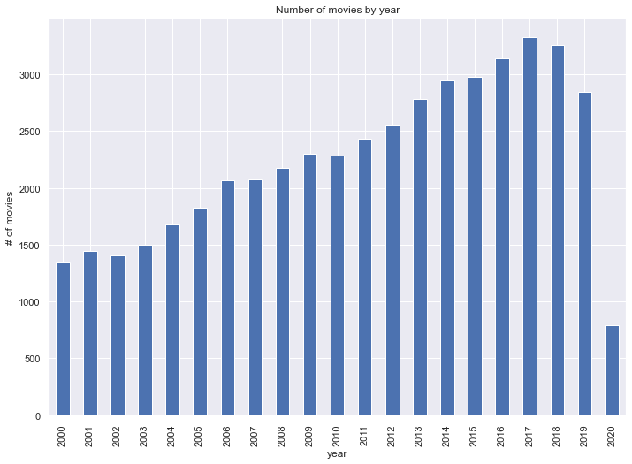
Data Visualization
Data Visualization
Notes:
Fantasy was the highest earning genre by producing about $2.7B for example avatar…

Slide 5
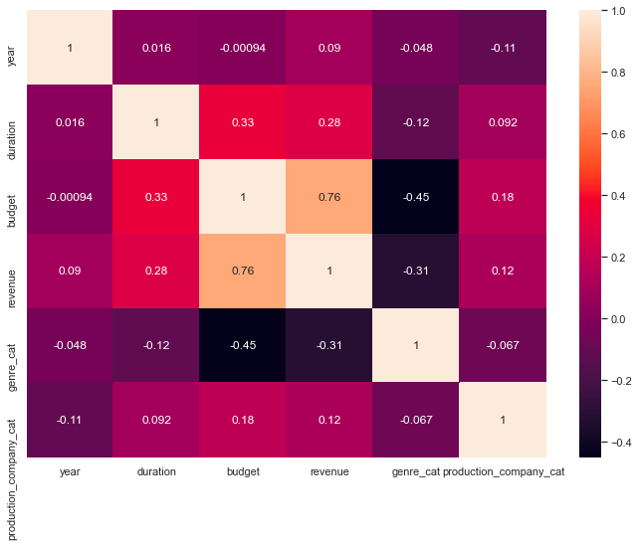
Correlation Matrix

Slide 6
Model Performance R² - 82.20%

Slide 7
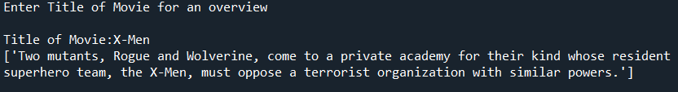
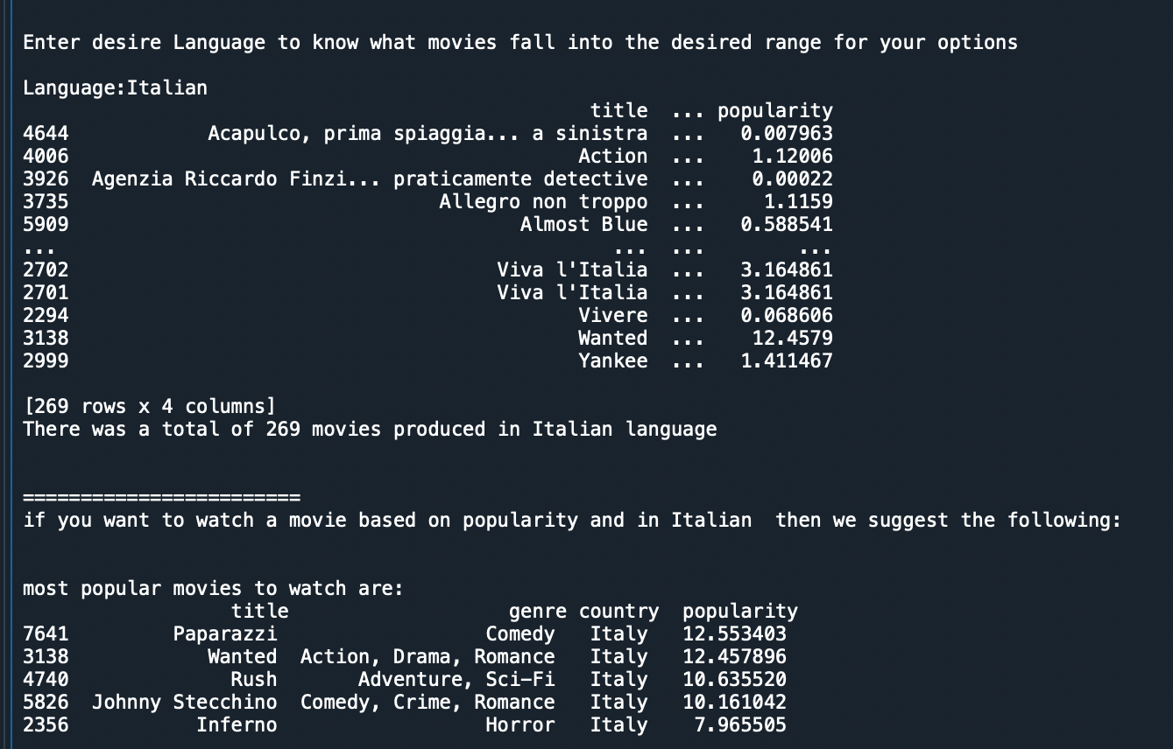
User interactive
User Interactive
Input: "Enter movie title of interest"
Output: movie's description
Input: "Learn more about movies in specific language"
Output: list of movies in selected language, preliminary information, and recommended movies in specified language based on popularity
Providing users with suggestions on movies to watch based on desired language and popularity
Notes:
Popularity is based on movies’ reviews

Slide 8

Methodology
2 Data sets (IMDB, Metadata)
130,000 Rows, 46 columns
Unique Id- IMDB_ID
Pandas, sklearn, seaborn, regression, matplotlib
Numeric codes for genres & production companies

Slide 9

Key Observations
Fantasy Genre
Budget, Genre, Production House
Our algorithm
Drama, Comedy, Romance
Production in 2018-2020
Least production in 2020

Slide 10


Slide 11
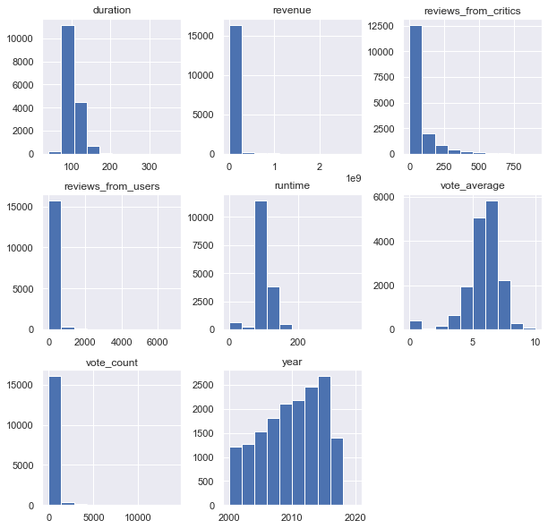
Appendix
Data Visualization

